Slide 1


2-D Cluster Variation Method
Base Code
with
Alianna J. Maren, Ph.D.
Verification and Validation
January 24, 2018

Slide 2

Alianna J. Maren, Ph.D.
Previous work in:
Neural networks,
Sensor fusion, and
Text analytics
Four patents:
Biologically-based sensor fusion
Knowledge discovery
Predictive analytics
Evidence-based reasoning
Recent publications in Brain-Computer Information Interfaces
Links to all at:
www.aliannajmaren.com

Slide 3
A Single Zigzag Chain
Showing the Configuration Variables x_{i}, y_{i}, w_{i}, and z_{i}

Slide 4


1-D Configuration Variable Values when h = 1
Envelope configuration: wraparound horizontally only
Total number of triplets = number of units
Horizontal wrap-around; identical with leftmost units
Legend
Configuration Variable (Triplet) Values Equiprobable when h = 1
z₁ = 0.125
Z₁ = 2
z₂ = 0.125
Z₂ = 2
z_{2var} = 0.125
Z_{2 var} = 2
variant
z₃ = 0.125
Z₃= 2
Unit in state A
Unit in state B
A
A
A
B
A
A
A
B
B
A
A
A
Wrap-around unit in state A
Wrap-around unit in state B
B
z₆ = 0.125
Z₆= 2
B
z₅ = 0.125
Z₅ = 2
A
z₅ = 0.125
Z₅ = 2
variant
A
z₄ = 0.125
Z₄ = 2
B
B
B
A
B
B
B
B
z_{i} = fraction of triplets of type i; Z_{i} = total number of triplets of type i

Slide 5
2-D Configuration Variable Values when h = 1
Vertical wrap-around; identical with bottom row
Envelope configuration: wraparounds vertically and horizontally
Total number of triplets = 2*number of units
Horizontal wrap-around; identical with leftmost units
Legend
Configuration Variable (Triplet) Values Equiprobable when h = 1
z₁ = 0.125
Z₁ = 8
z₂ = 0.125
Z₂ = 8
z_{2var} = 0.125
Z_{2 var} = 8
variant
z₃ = 0.125
Z₃= 8
Unit in state A
Unit in state B
A
A
A
B
A
A
A
B
B
A
A
A
Wrap-around unit in state A
Wrap-around unit in state B
B
z₆ = 0.125
Z₆= 8
B
z₅ = 0.125
Z₅ = 8
A
z₅ = 0.125
Z₅ = 8
variant
A
z₄ = 0.125
Z₄ = 8
B
B
B
A
B
B
B
B
z_{i} = fraction of triplets of type i; Z_{i} = total number of triplets of type i

Slide 6
The 2-D CVM Grid Can Serve as a Hidden Layer in a Computational Engine
External States ₂
Markov Blanket: Active Units (a)
A
B
B
B
A
A
A
A
B
A
Internal States
A
B
B
B
A
Representational units
(r)
A
A
A
B
A
Markov Blanket: Sensing Units (s)
External States ₁

Slide 7
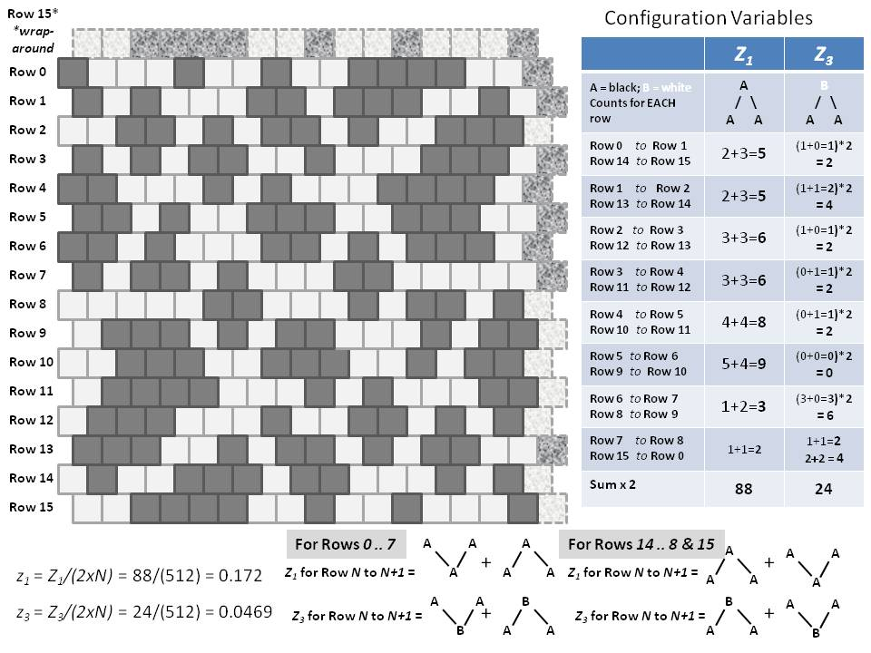
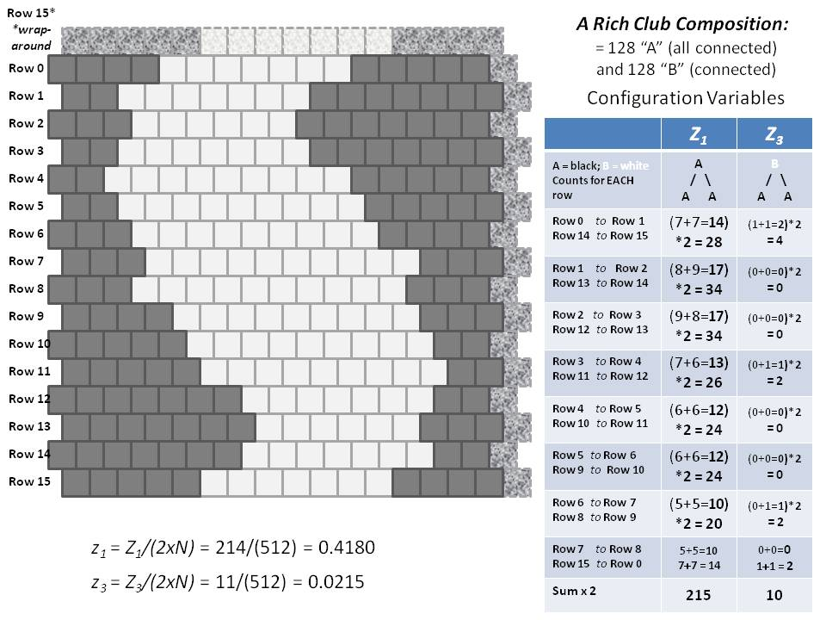
Two Different Configurations for a 2-D CVM Grid
Equiprobable unit distribution (x₁ = x₂ = 0.5)
Grid contains 256 units (16 x 16)
(a)
Scale-free-like topography
(b)
Extreme rich club-like topography

Slide 8
Row 15*
*wrap-around
A Rich Club Composition:
= 128 “A” (all connected)
and 128 “B” (connected)
Row 0
Row 1
Configuration Variables
Row 2
 | Z₁ | Z₃
A = black; B = white Counts for EACH row | A / \ A A | B / \ A A
Row 0 to Row 1 Row 14 to Row 15 | (7+7=14) *2 = 28 | (1+1=2)*2 = 4
Row 1 to Row 2 Row 13 to Row 14 | (8+9=17) *2 = 34 | (0+0=0)*2 = 0
Row 2 to Row 3 Row 12 to Row 13 | (9+8=17) *2 = 34 | (0+0=0)*2 = 0
Row 3 to Row 4 Row 11 to Row 12 | (7+6=13) *2 = 26 | (0+1=1)*2 = 2
Row 4 to Row 5 Row 10 to Row 11 | (6+6=12) *2 = 24 | (0+0=0)*2 = 0
Row 5 to Row 6 Row 9 to Row 10 | (6+6=12) *2 = 24 | (0+0=0)*2 = 0
Row 6 to Row 7 Row 8 to Row 9 | (5+5=10) *2 = 20 | (0+1=1)*2 = 2
Row 7 to Row 8 Row 15 to Row 0 | 5+5=10 7+7 = 14 | 0+0=0 1+1 = 2
Sum x 2 | 215 | 10
Row 3
Row 4
Row 5
Row 6
Row 7
Row 8
Row 9
Row 10
Row 11
Row 12
Row 13
Row 14
Row 15
z₁ = Z₁/(2xN) = 214/(512) = 0.4180
z₃ = Z₃/(2xN) = 11/(512) = 0.0215

Slide 9
Details of Counting Triplets for the Two Different Grid Configurations
 | Z₁ | Z₃
A = black; B = white | A / \ A A | B / \ A A
Row 2 to Row 1 | 7+7=14 | 1+1=1
Row 3 to Row 2 | 8+9=17 | 0+0=0
Row 4 to Row 3 | 9+8=17 | 0+0=0
Row 5 to Row 4 | 7+6=13 | 1+0=1
Row 6 to Row 5 | 6+6=12 | 0+1=1
Row 7 to Row 6 | 6+6=12 | 0+0=0
Row 8 to Row 7 | 5+5=10 | 1+0=1
Row 9 to Row 8 | 5+5=10 | 0+0=0
Sum x 2 | 150 | 10
 | Z₁ | Z₃
A = black; B = white Counts for EACH row | A / \ A A | B / \ A A
Row 0 to Row 1 Row 14 to Row 15 | 7+7=14 | (0+1=1)*2 = 2
Row 1 to Row 2 Row 13 to Row 14 | 8+9=17 | (1+1=2)*2 = 4
Row 2 to Row 3 Row 12 to Row 13 | 9+8=17 | (1+0=1)*2 = 2
Row 3 to Row 4 Row 11 to Row 12 | 7+6=13 | (0+1=1)*2 = 2
Row 4 to Row 5 Row 10 to Row 11 | 6+6=12 | (0+1=1)*2 = 2
Row 5 to Row 6 Row 9 to Row 10 | 6+6=12 | (0+0=0)*2 = 0
Row 6 to Row 7 Row 8 to Row 9 | 5+5=10 | (0+1=1)*2 = 2
Row 7 to Row 8 Row 15 to Row 0 | 5+5=10 8+7 = 15 | 0+0=0 1+1 = 2
Sum x 2 | 88 | 24

Slide 10
Row 15*
*wrap-around
Configuration Variables
 | Z₁ | Z₃
A = black; B = white Counts for EACH row | A / \ A A | B / \ A A
Row 0 to Row 1 Row 14 to Row 15 | 2+3=5 | (1+0=1)*2 = 2
Row 1 to Row 2 Row 13 to Row 14 | 2+3=5 | (1+1=2)*2 = 4
Row 2 to Row 3 Row 12 to Row 13 | 3+3=6 | (1+0=1)*2 = 2
Row 3 to Row 4 Row 11 to Row 12 | 3+3=6 | (0+1=1)*2 = 2
Row 4 to Row 5 Row 10 to Row 11 | 4+4=8 | (0+1=1)*2 = 2
Row 5 to Row 6 Row 9 to Row 10 | 5+4=9 | (0+0=0)*2 = 0
Row 6 to Row 7 Row 8 to Row 9 | 1+2=3 | (3+0=3)*2 = 6
Row 7 to Row 8 Row 15 to Row 0 | 1+1=2 | 1+1=2 2+2 = 4
Sum x 2 | 88 | 24
Row 0
Row 1
Row 2
Row 3
Row 4
Row 5
Row 6
Row 7
Row 8
Row 9
Row 10
Row 11
Row 12
Row 13
Row 14
Row 15
For Rows 0 .. 7
A
A
A
For Rows 14 .. 8 & 15
+
A
+
A
A
z₁ = Z₁/(2xN) = 88/(512) = 0.172
Z₁ for Row N to N+1 =
A
A
A
Z₁ for Row N to N+1 =
A
A
A
z₃ = Z₃/(2xN) = 24/(512) = 0.0469
A
A
B
B
A
A
Z₃ for Row N to N+1 =
+
Z₃ for Row N to N+1 =
+
B
A
A
A
A
B

Slide 11
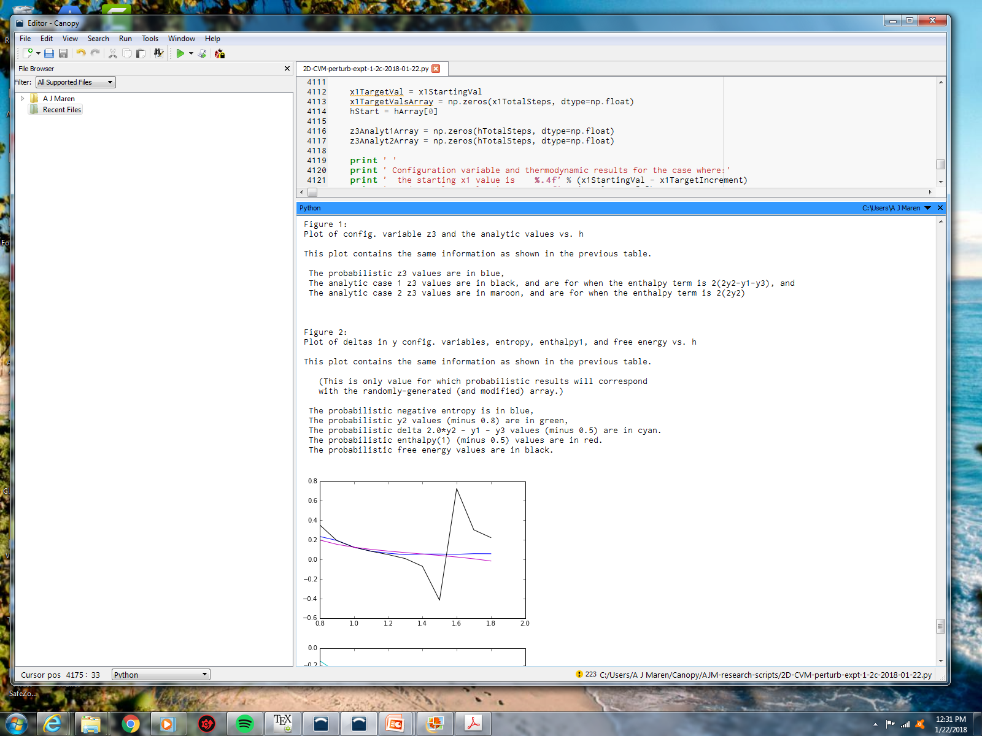
Configuration Variables and Analytic Results
x1= 0.50, h = 0.8 to 1.8

Slide 12
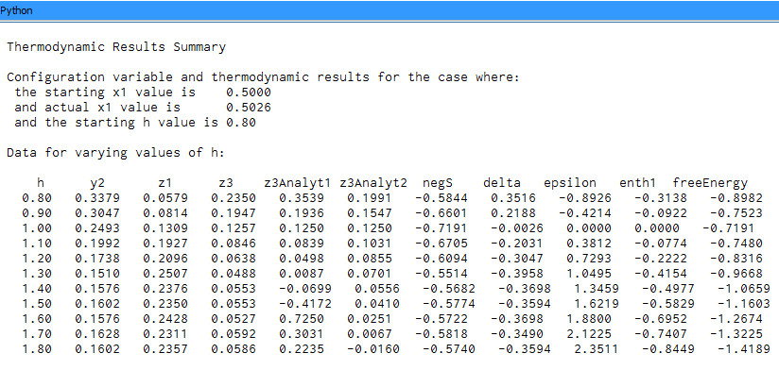
Configuration Variables and Analytic Results
x1= 0.50, h = 0.8 to 1.8

Slide 13
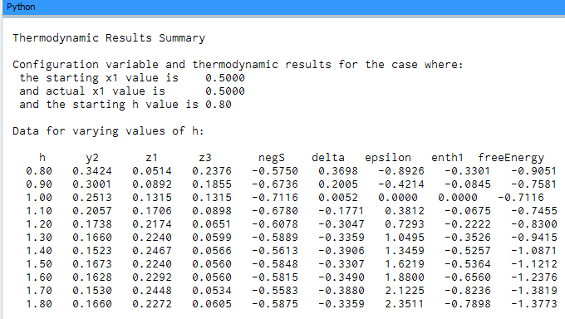
Experimental Results
x= 0.50, h = 0.8 – 1.8, and perturbation = 0.1

Slide 14
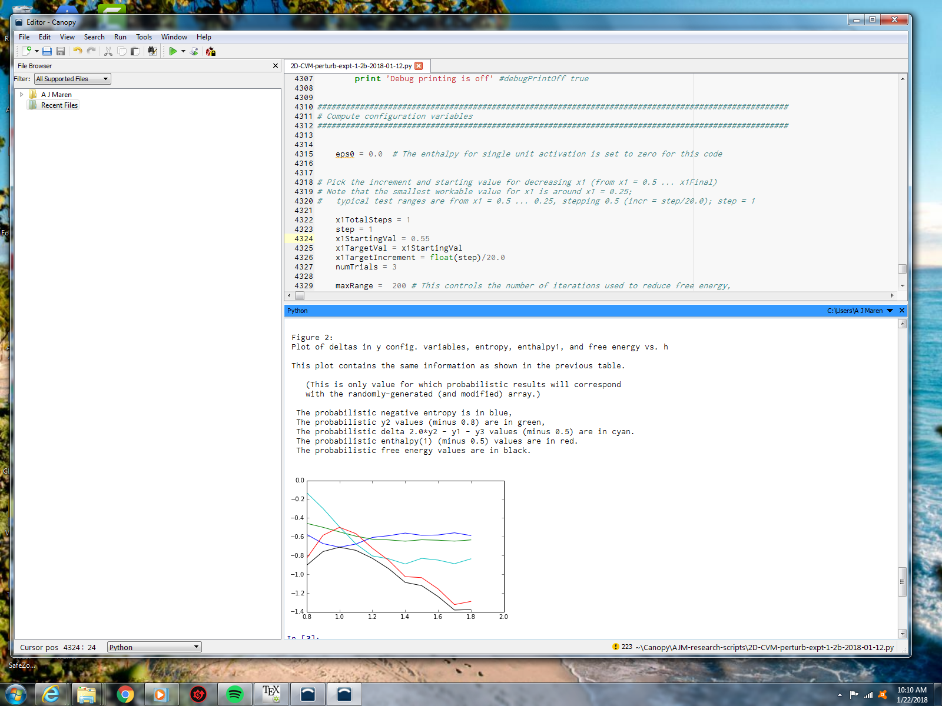
Experimental Results
x1= 0.50, h = 0.8 to 1.8

Slide 15
Configuration Variables and Thermodynamic Results
x1= 0.50, h = 0.8 to 1.8
delta =
2y₂ – y₁ – y₃ – 0.5
y₂ – 0.8
enthalpy – 0.5
neg-entropy
free energy
y₂, delta, and enthalpy all have scalars subtracted to bring them into the same visual field as entropy and free energy.
h-value

Slide 16
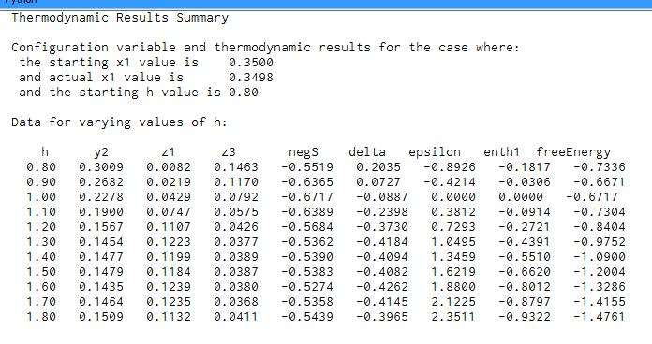
Experimental Results
x= 0.35, h = 0.8 – 1.8, and perturbation = 0.1

Slide 17
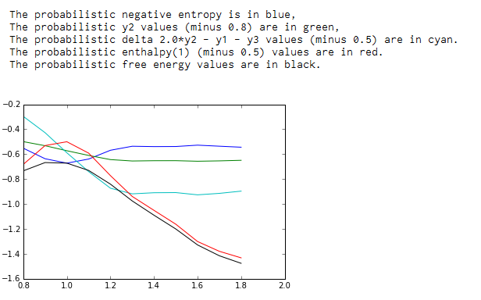
Experimental Results
x1= 0.35, h = 0.8 to 1.8

Slide 18
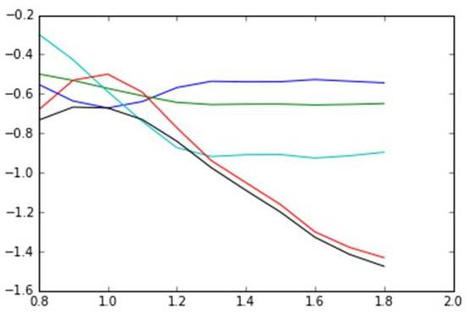
Configuration Variables and Thermodynamic Results
x1= 0.35, h = 0.8 to 1.8
delta =
2y₂ – y₁ – y₃ – 0.5
y₂ – 0.8
enthalpy – 0.5
neg-entropy
free energy
y₂, delta, and enthalpy all have scalars subtracted to bring them into the same visual field as entropy and free energy.
h-value

Slide 19
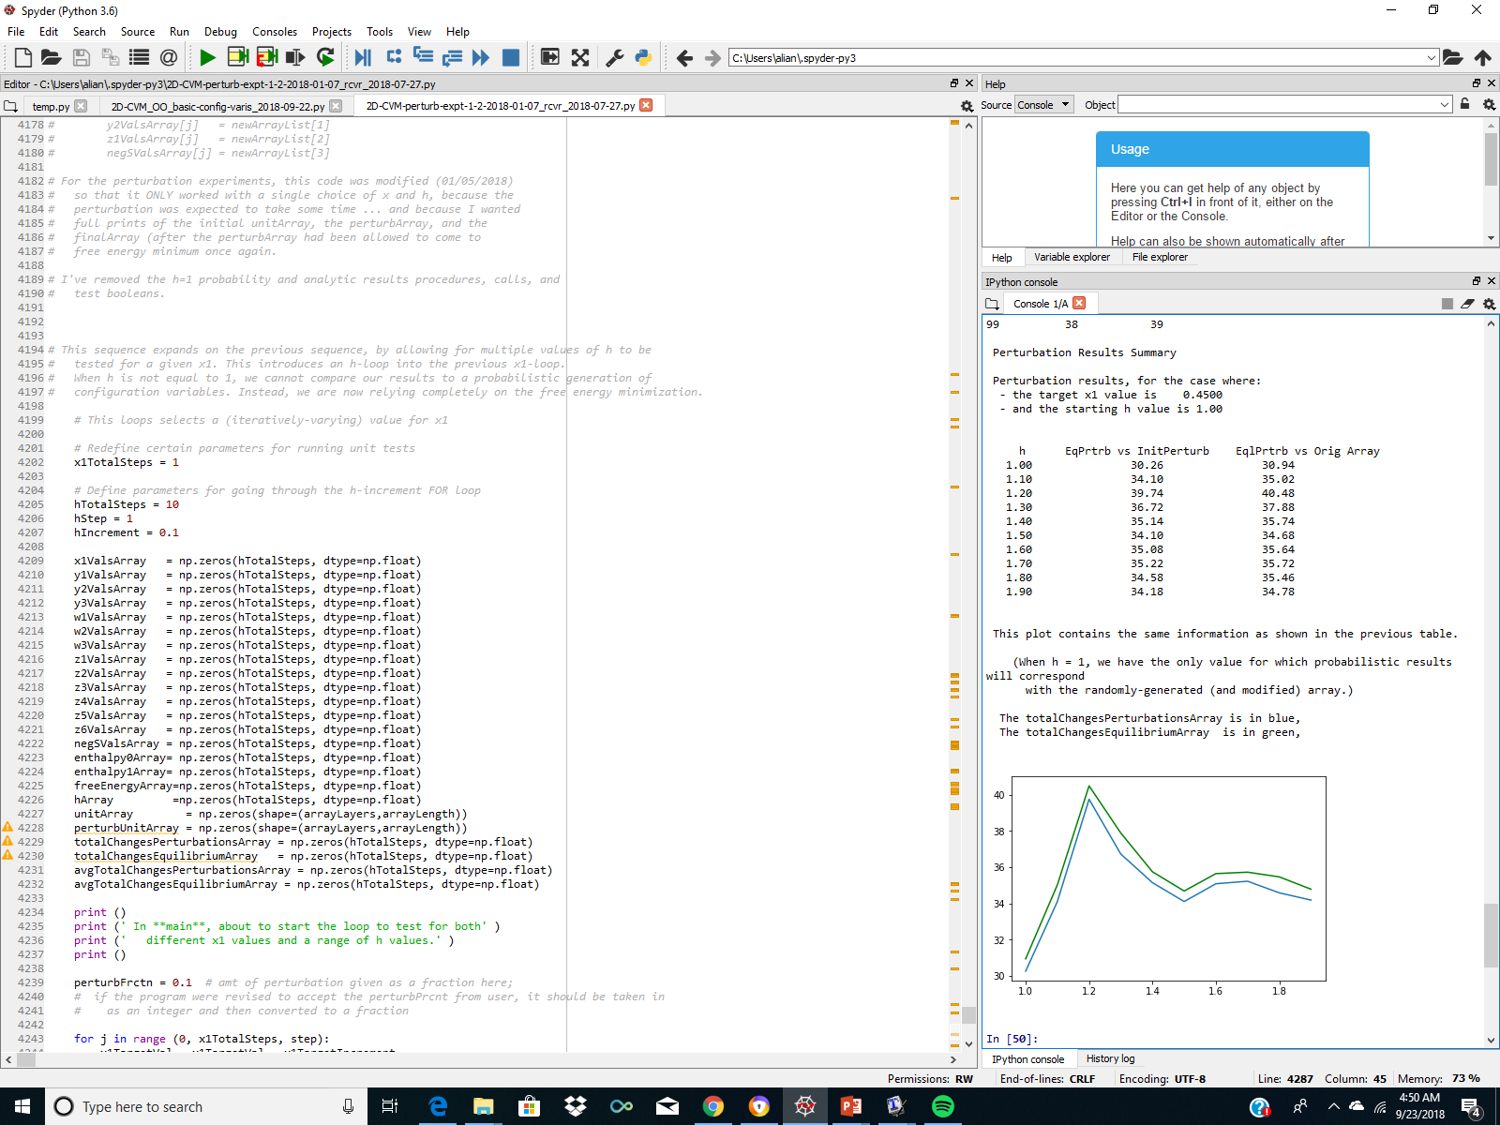
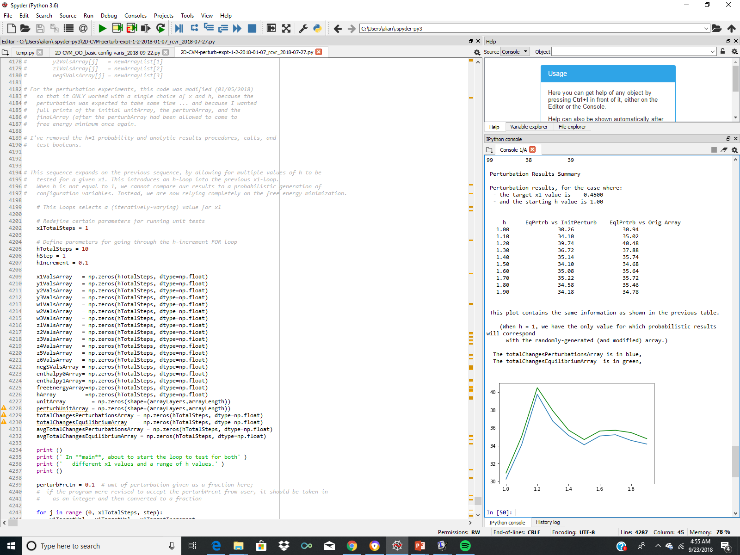
Experimental Results
x1= 0.45, h = 1.0 .. 1.9
totalChanges-Equilibrium-Array
totalChanges-Perturbation-Array
Data from:
2D-CVM-pertub-expt-1-2-2018-01-07_ rcvr_2018-07-27.py
Program run: 2018-09-23
h-value
Key parameter values:
x1 = 0.45
h = 1.0 .. 1.8
numTrials = 100

Slide 20
Experimental Results
x1= 0.45, h = 1.0 .. 1.x

Slide 21
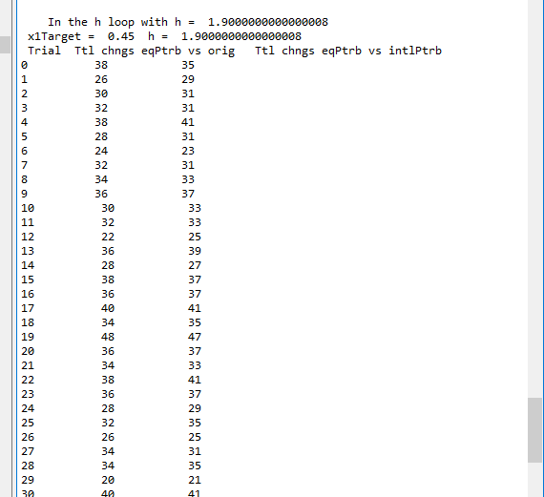
Experimental Results
x1= 0.45, h = 1.0 .. 1.x
Data from:
2D-CVM-pertub-expt-1-2-2018-01-07_ rcvr_2018-07-27.py
Program run: 2018-09-23
Example of data output for h=1.90.(Data shown up through Trial 30, starting at Trial 0; total of 100 trials. )

Slide 22
For More Information:
GitHub Public Repository:
https://github.com/ajmaren/2D-Cluster-Variation-Method
Website:
www.aliannajmaren.com
Code Availability:
Code will be made available on the public GitHub repository after initial development, documentation, V&V, and experiments are completed.
Look on arXiv for various papers documenting theoretical and experimental results. See the “Patents and Publications” page on www.aliannajmaren.com for full access to the latest papers.
Contact Information:
Alianna J. Maren, Ph.D.:
alianna@aliannajmaren.com
alianna.maren@northwestern.edu

